Slide 1
Air-Bending
Locomotion & Interaction Technique

Slide 2
How to Airbend

Slide 3
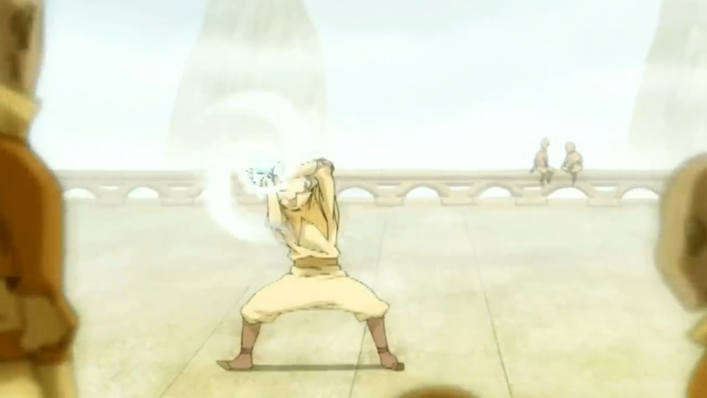
Air-Scooter(locomotion)
Goal: create a new VR locomotion technique inspired by Avatar: The Last Airbenders Air-Scooter that he uses to travel.
We, The player is Aang on the air-scooter and our hand gestures and movements propels us in all 3 planes of motion.

Slide 4
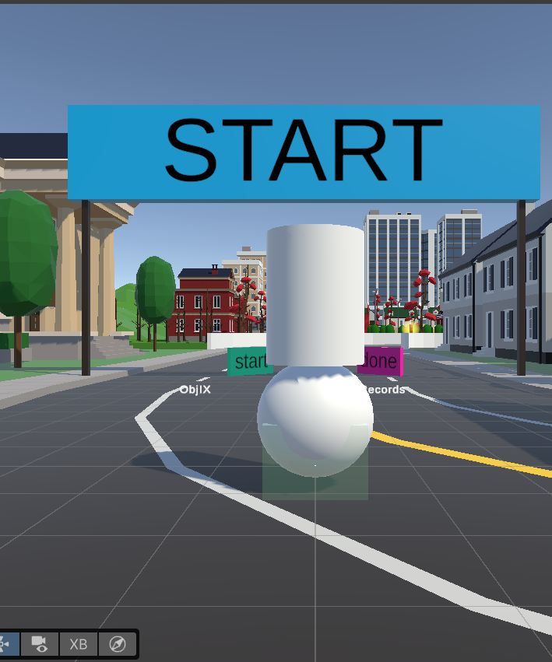
Current Features
Third-person avatar + follower camera
Locomotion:
Left-hand tilt → move (with calibration + control zone)
Right-hand swirl → discrete jump (cooldown + clamp)
Game integration works:
Banners trigger, timer starts, coins count
Interaction station loop works:
Enter zone → Pinch to start → solve → hold both pinches → return to locomotion

Slide 5
Architecture change from original repo
AvatarRoot = real physical body (Rigidbody + CapsuleCollider)
OVRCameraRig became a follower camera (no trigger collisions)
Fix: TriggerRelay + two colliders
Physics body on Default (ground collision)
BannerHitbox trigger on locomotion layer (talks to banners/coins/tasks)
Biggest issue was the repo assumed the rig is the player. I made a new body, then relayed triggers back into the existing logic to make it third person.

Slide 6
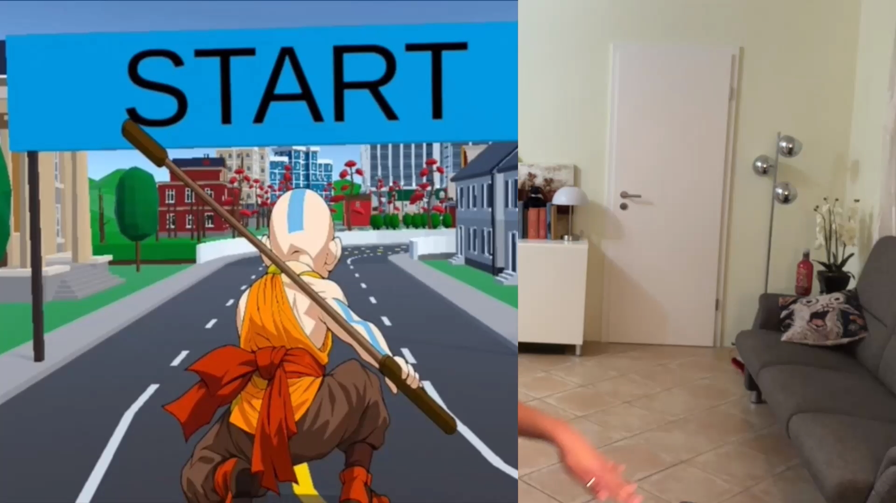
Locomotion design
Left hand:
Neutral calibration (fist/pinch)
Control zone so resting hands don’t move you
Left-hand tilt = move
Right-hand swirl = discrete jump
Right hand:
one deliberate swirl = one jump(gravity is on)
Comfort tweaks: slower backward, smoothing, speed clamp and hide/unhide UI

Slide 7
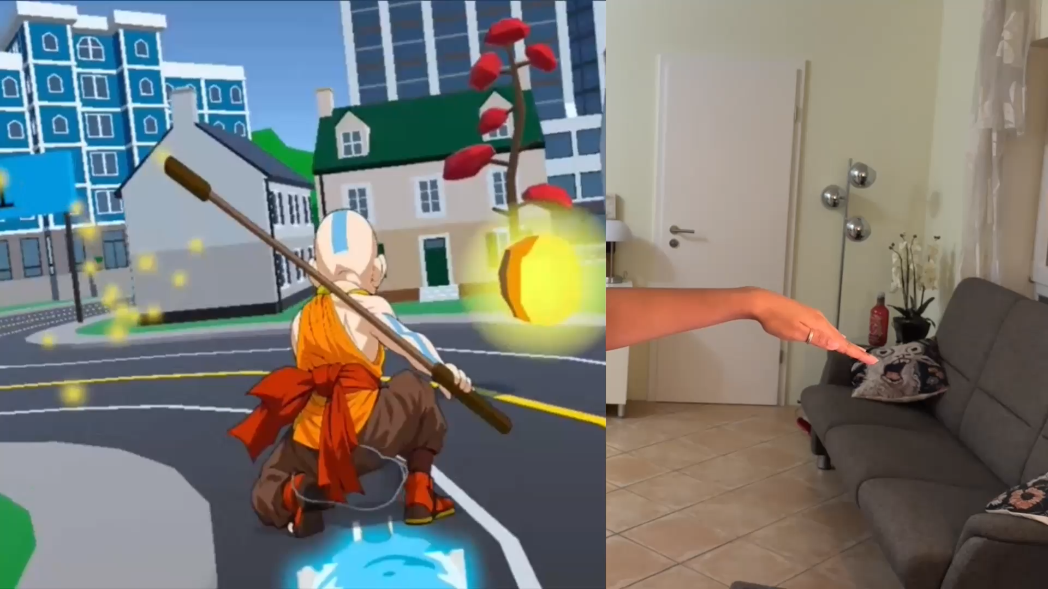
Interaction task
Enter checkpoint = UI appears (“Pinch left hand index and thumb to start”)
Locomotion turned off, current momentum cancelled and Aang takes a break to chill with Appa.
Controls (POV aligned):
Left index pinch + wrist rotate = rotation
Right index pinch + tilt(same tilt as locomotion) = move in XZ
Right middle pinch + up/down = Y axis
Hold both index pinches (~1s) = finish + return to locomotion

Slide 8
AirBending CheatSheet
Locomotion | Interaction
✋ Left hand in right infront(activation zone) | 🤏 Left Index pinch near task → Start
🧭 Tilt left hand wrist = move with below controls | Left hand: 🤏index + 🔄 rotate wrist = Rotate T
⬆️ forward · ⬇️ back | Right index(move in XZ): 🤏index + 🧭 tilt
⬅️ / ➡️ strafe · ↖️↗️↙️↘️ diagonals | Right middle(Move in Y): 🤏middle + ⬆️⬇️ hand up/down
✊ Left fist = recalibrate neutral or when stuck | 🤏🤏 Hold BOTH index pinches = Finish & Exit
🌀 Right hand swirl/whip = Jump up
Tip: look where you want to go or do .Movement is POV/yaw based.
Open both palm infront to hide/unhide UI

Slide 9
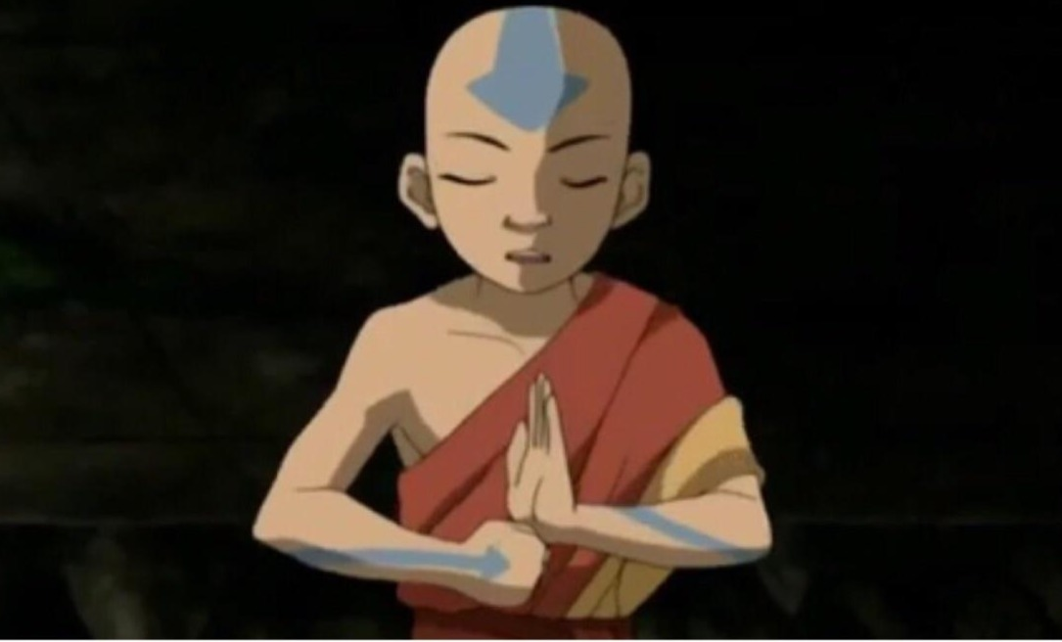
THANK YOU

